Slide 1

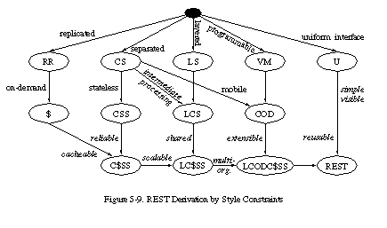
Representational
State Transfer
REST, ROA, and HATEOAS
Notes:
© SUPINFO International University - http://www.supinfo.com
SUPINFO vous permet de partager ce document
Vous êtes libre de :
Partager — reproduire, distribuer et communiquer ce document Remixer — modifier ce document
A condition de respecter les règles suivantes :
Indication obligatoire de la paternité — Vous devez obligatoirement préciser l’origine « SUPINFO » du document au début de celui-ci de la même manière qu’indiqué par SUPINFO International University – Notamment en laissant obligatoirement la première et la dernière page du document, mais pas d'une manière qui suggérerait que SUPINFO International University vous soutiennent ou approuvent votre utilisation du document, surtout si vous le modifiez. Dans ce dernier cas, il vous faudra obligatoirement supprimer le texte « SUPINFO Official Document » en tête de page et préciser notamment la page indiquant votre identité et les modifications principales apportées.
En dehors de ces dispositions, aucune autre modification de la première et de la dernière page du document n’est autorisée.
NOTE IMPORTANTE : Ce document est mis à disposition selon le contrat CC-BY-NC-SA Creative Commons disponible en ligne http://creativecommons.org/licenses ou par courrier postal à Creative Commons, 171 Second Street, Suite 300, San Francisco, California 94105, USA modifié en ce sens que la première et la dernière page du document ne peuvent être supprimées en cas de reproduction, distribution, communication ou modification. Vous pouvez donc reproduire, remixer, arranger et adapter ce document à des fins non commerciales tant que vous respectez les règles de paternité et que les nouveaux documents sont protégés selon des termes identiques. Les autorisations au-delà du champ de cette licence peuvent être obtenues à support@supinfo.com.
© SUPINFO International University – EDUCINVEST - Rue Ducale, 29 - 1000 Brussels Belgium . www.supinfo.com

Slide 2

REST
Course objectives
By completing this course, you will be able to:
Explain how HTTP works
Define REST constraints
Consume Web APIs

Slide 3


REST
Course topics
Course’s plan:
HTTP Reminders
RESTful Architecture

Slide 4

HTTP Reminders
The Web Protocol

Slide 5


The Protocol
Client - Server
HyperText Transfer Protocol
Communications protocol developed for Web
Request/Response protocol
Stateless

Slide 6
Request Message
Client - Server
Composed of:
A request line composed of:
The request method used
The resource URI
The protocol and the version used
Several Headers
An empty line
An optional message body

Slide 7
HTTP request message
Client - Server
POST /en/html/index.html HTTP/1.1
Host: www.website.com
User-Agent: Mozilla/5.0 (Windows;en-GB; rv:1.8.0.11)
Accept: text/xml,text/html;q=0.9,text/plain;q=0.8,image/png,*/*;q=0.5
Accept-Language: en-gb,en;q=0.5
Accept-Encoding: gzip,deflate
Accept-Charset: ISO-8859-1,utf-8;q=0.7,*;q=0.7
Keep-Alive: 300
Connection: keep-alive
Content-Type: application/x-www-form-urlencoded
Content-Length: 39
name=MyName&male=yes

Slide 8
HTTP request methods
Client - Server
HTTP defines nine methods (or verbs):
GET: Request a representation of the resource
POST: Submit data to be processed to the identified resource
PUT: Uploads a representation of the specified resource
DELETE: Deletes the specified resource
…

Slide 9
Response Status Codes
Client - Server
Status codes are divided into five classes :
1xx : Informational
Indicates a provisional response
2xx : Success
Indicates the request was received, understood, accepted and processed successfully
Examples :
200 OK
201 Created

Slide 10
Response Status Codes
Client - Server
Status codes are divided into five classes :
3xx : Redirection
Indicates that further action needs to be taken by the user agent in order to fulfill the request
Example :
301 Moved Permanently

Slide 11
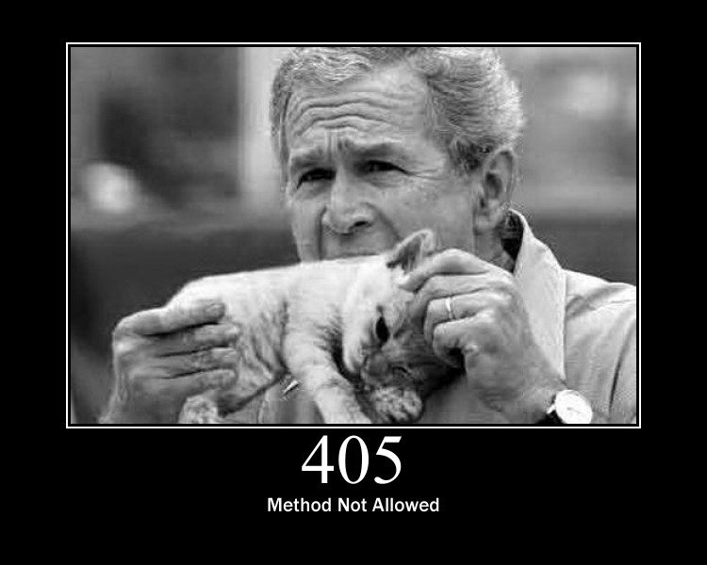
Response Status Codes
Client - Server
Status codes are divided into five classes :
4xx : Client Error
Intended for cases in which the client seems to have erred
Examples :
403 Forbidden
404 Not Found
405 Method Not Allowed

Slide 12
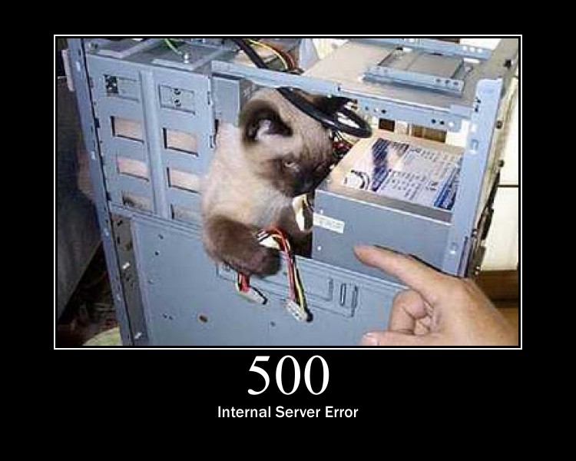
Response Status Codes
Client - Server
Status codes are divided into five classes :
5xx : Server Error
Indicate the server is aware that it has encountered an error or is otherwise incapable of performing the request
Examples :
500 Internal Server Error
501 Not Implemented

Slide 13


Questions ?

Slide 14
RESTful Architecture
Representational State Transfer

Slide 15
What is REST ?
RESTful Architecture
The term comes from Roy Fielding’s doctoral dissertation
REpresentational State Transfer
REST was initially described in the context of HTTP, but it is not limited to that protocol
Notes:
Roy Thomas Fielding is a co-creator of HTTP 1.0, HTTP 1.1, and URI RFCs

Slide 16
What is REST ?
RESTful Architecture
Roy defines a RESTful system with the following constraints :
It must be a client-server system
It has to be stateless
It has to support a caching system
It has to be uniformly accessible
It has to be layered (support scalability)
It may be able to transfer executable code

Slide 17
Client-Server system
RESTful Architecture
Separation of concerns
Separation between the clients & data storage
Simple server components
Portability improvement
Scalability improvement

Slide 18
Stateless
RESTful Architecture
Each request must contain all of the information necessary to understand it
No stored context on the server
Session state is on the client

Slide 19
Cache
RESTful Architecture
Responses must be implicitly or explicitly labeled as cacheable or non-cacheable
Potential intermediary components:
Proxies, Shared caches
Always think about the durability

Slide 20
Uniform Interface (UCCSS)
RESTful Architecture
Standard format and interactions
4 constraints:
Identification of resources (URI)
Standard representations (media-type)
Self-descriptive (semantic, metadata)
Hypermedia driven (HATEOAS)
Notes:
HATEOAS, an abbreviation for Hypermedia as the Engine of Application State, is a constraint of the REST application architecture that distinguishes it from most other network application architectures.

Slide 21
Uniform Interface (UCCSS)
RESTful Architecture
Advantages
Easily interoperable
Independent evolvability
Disadvantages
Not optimal for specific interactions

Slide 22
Layered System (ULCCSS)
RESTful Architecture
Promote substrate independence
Protect new services from legacy clients
Enable load balancing

Slide 23
Code-On-Demand
RESTful Architecture
Optional
Scripts for the client (applets/JavaScript)
Improve system extensibility
Enable load balancing

Slide 24
Implementations
RESTful Architecture
HTTP 1.1
WebDAV (partial)
APP / Atom
GData, OData

Slide 25
Resource
RESTful Architecture
A RESTful resource is anything that is addressable over the Web
Resource examples are :
The temperature in Paris at 8:00 PM
A blog post
A list of Bug Reports inside a BTS
A search result in Google

Slide 26
Representation
RESTful Architecture
A Representation is typically a document that captures the current or intended state of a resource
It’s what is sent back and forth between clients and servers

Slide 27
Representation
RESTful Architecture
Can take various form such as :
One resource can have more than one representation
But with the same URI
HTML Document
Plain Text
XML Stream
JSON Stream
…

Slide 28
RESTful Web Services
RESTful Architecture
Also called RESTful web API, it’s a simple web service implemented using HTTP and the principles of REST
The URI of a resource is available as an hyperlink in the representations

Slide 29
RESTful Web Services
RESTful Architecture
The HTTP protocol provides methods on which we can map CRUD operations
And so apply different actions with the same URI !
Data Action | HTTP protocol equivalent
CREATE | POST
RETRIEVE | GET
UPDATE | PUT
DELETE | DELETE

Slide 30
A Web API Example
RESTful Architecture
An example of a Web API is available at the following URL :
http://restful-example.appspot.com/
It provides CRUD operations on a student list
We’ll use them as example in the course

Slide 31
GET / Retrieve
RESTful Architecture
A GET request to the URI /students return all the students :
<students>
<count>2</count>
<student>
<birthDate>5287-09-15T22:00:13.524Z</birthDate>
<firstName>Jack</firstName>
<idBooster>59253</idBooster>
<lastName>Harkness</lastName>
</student>
...
</students>

Slide 32
GET / Retrieve
RESTful Architecture
And a GET request to the URI /students/59253 returns Jack:
<student>
<birthDate>5287-09-15T22:00:13.524Z</birthDate>
<firstName>Jack</firstName>
<idBooster>59253</idBooster>
<lastName>Harkness</lastName>
</student>

Slide 33
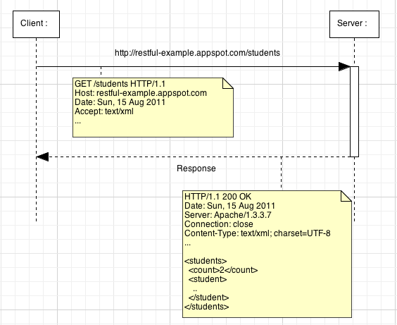

Slide 34
POST / Create
RESTful Architecture
We want to add Joe
A Joe XML representation looks like this :
<student>
<birthDate>1946-06-28T22:00:13.524Z</birthDate>
<firstName>Joe</firstName>
<idBooster>65442</idBooster>
<lastName>Dalton</lastName>
</student>

Slide 35
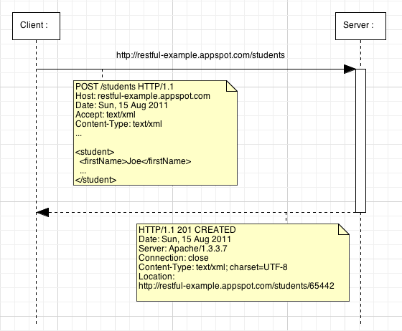
Notes:
The response of a POST request can contain a body but in that example we prefer use the 201 status code with a Location header with the new resource URI.

Slide 36
PUT / Update
RESTful Architecture
We want to update Joe
Updated Joe representation looks like this :
<student>
<birthDate>1946-06-28T22:00:13.524Z</birthDate>
<firstName>Joeffrey</firstName>
<idBooster>65442</idBooster>
<lastName>Dalton</lastName>
</student>

Slide 37
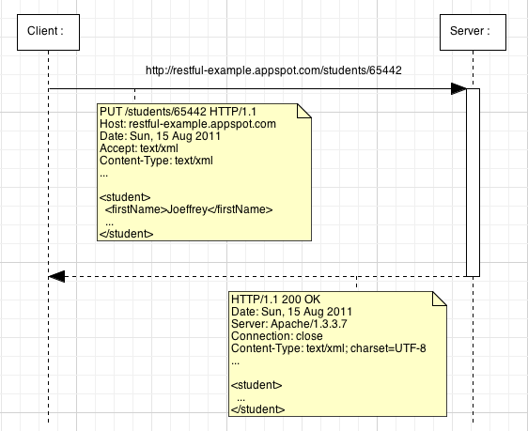

Slide 38
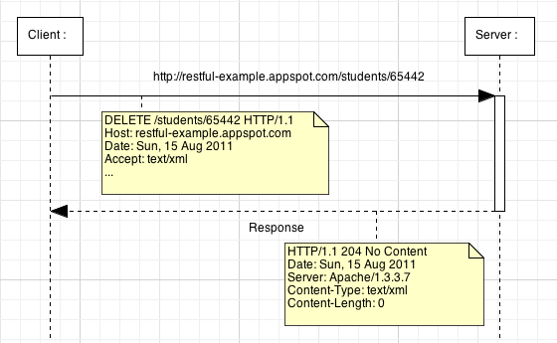
DELETE / Delete
RESTful Architecture

Slide 39
RESTful Web Services
RESTful Architecture
Web API are not always simple CRUD
Choose the verb that best matches to the behavior of your service !

Slide 40
Questions ?

Slide 41
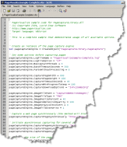

Exercise (1/2)
REST
Create a Web application that uses the Web API of http://restful-example.appspot.com

Slide 42
Exercise (2/2)
REST
No need to use a server side technology
Just use JavaScript !
Your application must have the following features:
Use polling to fetch students list updates !
List all the students
Add a new student
Remove a student
Notes:
Polling=send an ajax requests regularly

Slide 43


